Slide 1
T-110.5190 IWORK
Research topics
17.01.2011
Yrjö Raivio
Aalto University, School of Science
Department of Computer Science and Engineering
Data Communications Software
Email: yrjo.raivio@tkk.fi

Slide 2
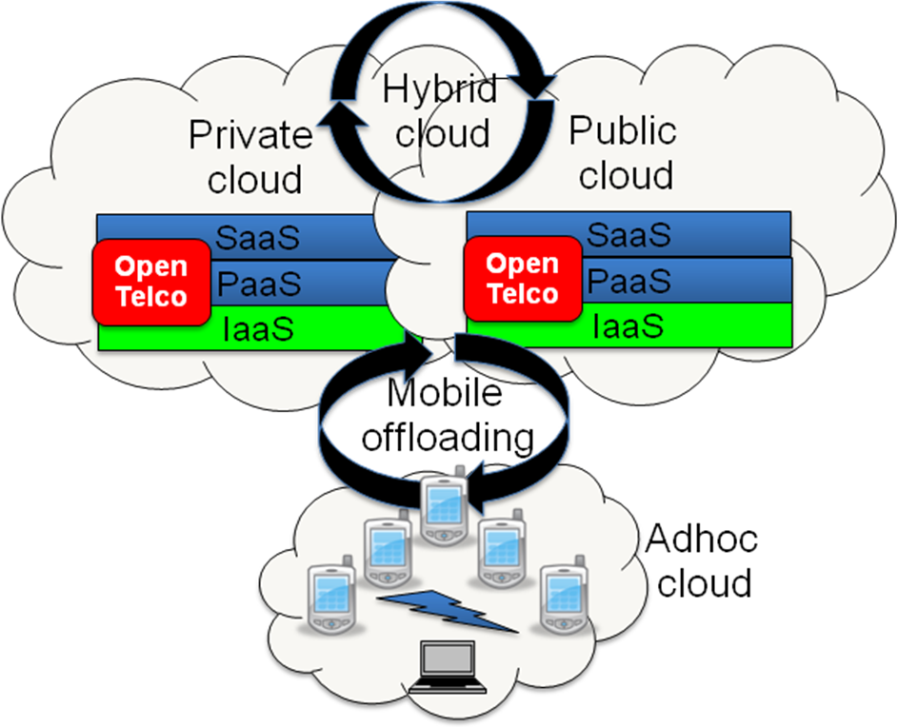
Mobile Cloud

Slide 3
1) Handling dynamic traffic loads by a hybrid cloud

Slide 4
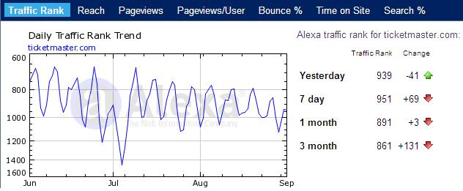
Ticket sales variations
Public cloud
Private cloud
Source: http://www.alexa.com/siteinfo/ticketmaster.com#

Slide 5
SMS traffic variations – example from New Year´s Eve
Public cloud
Private cloud
Source: Zerfos, P., Meng, X., Wong, S.H.Y. and Samanta, V., 2006. A study of the Short Message
Service of a nationwide cellular network. (IMC ’06), Rio de Janeiro, Brazil 25-27 October 2006.

Slide 6
Research target
Dynamic traffic handling is not a trivial question. You should evaluate the challenges incorporated. What are the requirements for the hybrid infrastructure? How do you manage the dynamic load changes, based on historic or monitoring data or both? When does the hybrid approach make sense? When it does not?

Slide 7
References
M. Hajjat, X. Sun, Y-W. E. Sung, D. Maltz, S. Rao, K. Sripanidkulchai and M. Tawarmalani: Cloudward Bound: Planning for Benefitial Migration of Enterprise Applications to the Cloud, SIGCOMM 2010.
R. Moreno-Vozmediano, R.S. Montero and I.M. Llorente: Elastic Management of Cluster-based Services in the Cloud, ACDC 2009.
J. Gabriellson, O. Hubertsson, I. Más and R. Skog: Cloud Computing in telecommunications, Ericsson Review 1/2010.

Slide 8
Cost analysis of a hybrid cloud

Slide 9
Research target
The cost of the cloud depends on servers, infrastructure, power and network costs. In a hybrid architecture public cloud is the 5th cost factor.
Define a model to evaluate the costs of a private, a public and a hybrid cloud. What is the optimal solution for each product or company? What is the impact of the energy consumption? Where is the breakeven point for each alternative? You may assume that public cloud charging is based on Amazon EC2 pricing model.

Slide 10
References
A. Greenberg, J. Hamilton, D .A. Maltz and P. Patel: The Cost of a Cloud: Research Problems in Data Center Networks, ACM SIGCOMM Computer Communication Review, vol. 39, no. 1, Jan 2009.
A. Berl et al: Energy-Efficient Cloud Computing, The Computer Journal, vol. 53, no. 7, 2010.
E. Walker, W. Brisken and J. Romney: To Lease or Not to Lease from Storage Clouds, Computer, April 2010 (vol. 43 no. 4) pp. 44-50.

Slide 11
3) Offloading mobile binaries, user interfaces, content or applications

Slide 12
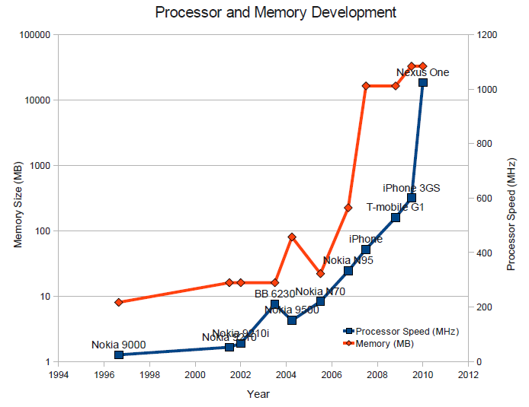
Mobile capablities
Bottleneck:
Battery
Source: Kemp et al, ”Cuckoo: a Computation Offloading Framework for Smartphones”, 2010

Slide 13
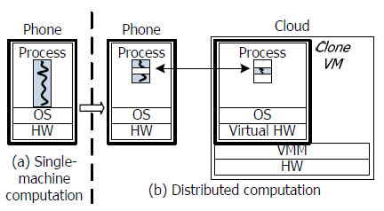
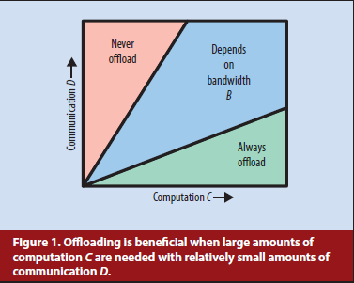
Mobile offloading
Source: Kumar & Lu, ”Cloud Computing for Mobile Users:
Can Offloading Computation Save Energy ”, 2010
Source: Chun & Maniatis, ”Augmented Smartphone Applications
Through Clone Cloud Execution”, 2009
Application example (by Kumar & Lu):
  Chess
  Position can be shown with 6 bits x 32 = 192 bits = 24 byte
  All possible combinations in a typical game: ~6⁸⁰ = 1.8 x 10⁶²
Application examples (by Kemp et al):
  Image processing
  Audio processing
  Text processing
  Artificial intelligence for games
  3D rendering
  Security

Slide 14
Research target
Basically we can offload the whole mobile binary (image) to cloud or restrict the offloading to only code blocks, user interfaces, applications or content.
You have a choice. You may either make a summary of the main research paths on the area, or you may focus on some sub area of the research. Can mobile offloading save energy? What is the cost of computation vs. communication? What is the optimal solution? What are the most vital use cases?

Slide 15
References
X. Zhang et al: Towards an Elastic Application Model for Augmenting Computing Capabilities of Mobile Platforms, Mobilware 2010.
K. Kumar and Y.-H. Lu: Cloud Computing for Mobile Users: Can Offloading Computation Save Energy? Computer, April 2010.
R. Kemp et al: Cuckoo: a Computation Offloading Framework for Smartphones, MobiCASE 2010.
B.-G Chun and P. Maniatis: Augmented Smartphone Applications Through Clone Cloud Execution, HotOS 2009.

